Slide 1
ETL-BI Project
Chirag Gajiwala

Slide 2
BI Deliverables
Performed BI dashboards, reports and visualizations using below mentioned tools.
Qliksense
Tableau
Powerpivot, Powerview, Power BI, Powermap and Excel 2013.

Slide 3
ETL Tools comparison
Microsoft SSIS:
It is a commercial, non open-source ETL tool developed by Microsoft having support for Hadoop and data integration on cloud as well.
It has direct access to data quality module by purchasing the module separately.
It has centralized metadata repository. It has change data capture.
It uses SCD transformation type 1,2 for SQL server only.
It has core capabilities of parallel processing, reusability and integrated scheduling.
Talend open studio free edition:
It is a non commercial, open source ETL tool having support for Hadoop and data integration on cloud.
It does not have direct access to data quality module unlike SSIS. It doesn’t have centralized metadata repository and lacks change data capture.
It used SCD transformation type 0-2.
It has core capability of parallel processing but lacks reusability and integrated scheduling.

Slide 4
Tools comparison
Criteria |  | Qlikview | Tableau | MS BI | Comment
Business Criteria | ======= ======= ======= |  |  |  | Speed, Scalability, Price
Implementation Speed |  | High | Good | Average | Qlikview is fastest to implement
Scalability |  | Limited by RAM | Very Good | Good | Need the expert in scalable SaaS
Pricing |  | Above Average | High | Average | Microsoft is the price leader
Licensing/support cost |  | High | High | Average | Smart Client is the best way to save
Enterprise Readiness |  | Good for SMB | Good for SMB | Excellent | Partners are the key to SMB market
Long-term viability |  | 1 product | Average | Excellent | Microsoft are 35+ years in business
Mindshare |  | Growing fast | Growing fast | 3rd attempt to win BI | Qlikview is a DV Leader, Successful IPO

Slide 5
Tableau Software : Without doubt Tableau set the pace for easy-to-use data visualization and exploration software. In practical terms this means business users can get to their data, typically without assistance from IT, and create graphs, charts and dashboards in a way that is most meaningful to them.
Authoring takes place on Tableau Desktop which, as a stand-alone environment, can perform its own analysis, either against the Tableau in-memory database, or against external data sources – databases, cloud data sources, spreadsheets and so on.
In a group or enterprise setting Tableau Server acts as a central facility for data access, delivering visualisations, enforcing security and managing user access. Tableau Server distributes visualisations through the web browser to almost any device that supports a web browser – desktops and mobile devices.
Likes: Lots of eye candy and attractive visualisations. Dislikes: Not much in the way of computational analytics and poor extensibility.

Slide 6
Qlik Sense
Likes: Very clever structuring of data for analysis purposes. Dislikes: None really, but could have more computational analytics capability.
Qlik Sense is a drag-and-drop data visualization and discovery platform capable of addressing most business intelligence needs apart from heavy duty production reporting. It delivers an easy-to-use interface suited to all levels of skill, and has a substantial amount of in-built intelligence to help users along.
Users can share their visualizations via various mechanisms and the platform was built ground up for mobile access – no matter the device (visualizations are rendered in HTML5).
Perhaps the most significant Qlik Sense differentiator is its associative data engine. This understands the links between various data sources and can suggest previously unsuspected relationships. Many suppliers use the term ‘data discovery’, but this facility adds new meaning to the term
It comes in two versions – Qlik Sense Desktop, which is free to download and is not throttled in any way. It runs on a Windows desktop and is capable of accessing many data sources. Qlik Sense as a platform runs on a server(s) and provides users with a browser based interface.

Slide 7
Microsoft Power BI
With two different options for subscription, it even allows the users to use it for free. Combining connections of Azure services and other third party connections like GitHub, it is definitely trying to integrate a lot.
It can produce predefined reports, charts for data on Github and other third party connections. A worksheet can be dynamically used and refreshed since it integrates other Microsoft services like excel and OneDrive.
Charts can be created in two different ways depending on your need. With 16 different types of charts offered by Power BI, it is surely taking a new direction towards BI that is altogether different from its competitors.
Power BI is the least capable but definitely has a value for money that attracts customers.

Slide 8
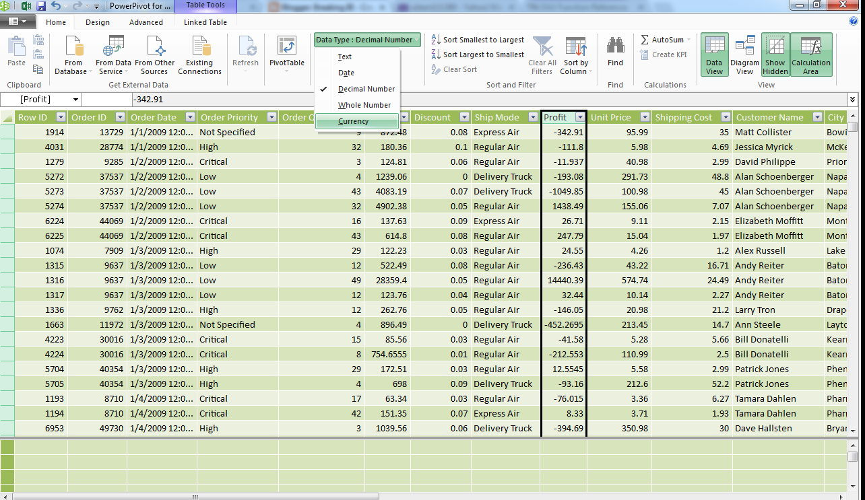
Power Pivot has a Currency data type, while Tableau does not. This was just a couple of clicks away in Power Pivot.

Slide 9
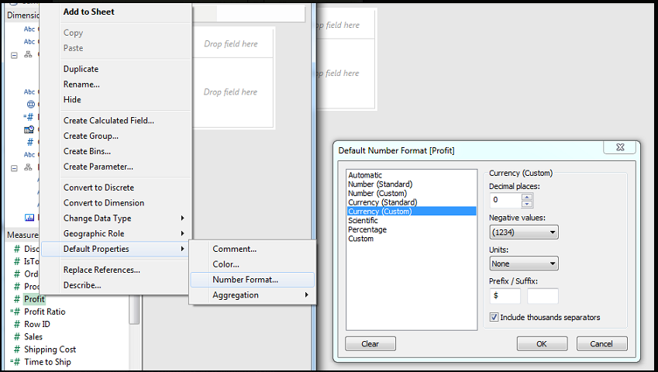
This was slightly more complex in Tableau because we had to go through two menus to get here. Tableau simply considers the data to be numeric and Currency is a display type.

Slide 10
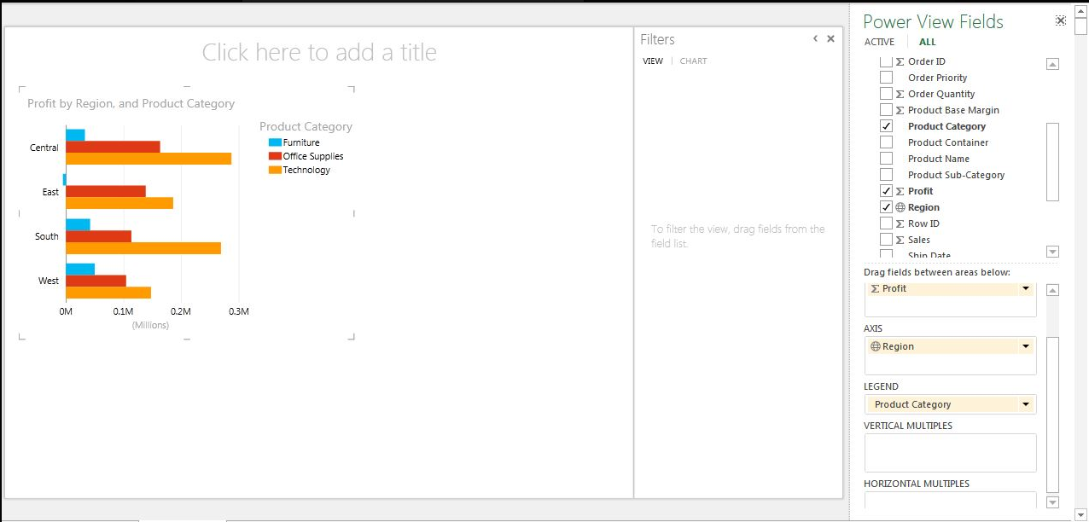
Bar Graph (1 measure by 2 dimensions) using Power view
This was just a couple of clicks. The labels and the aesthetics are acceptable.

Slide 11
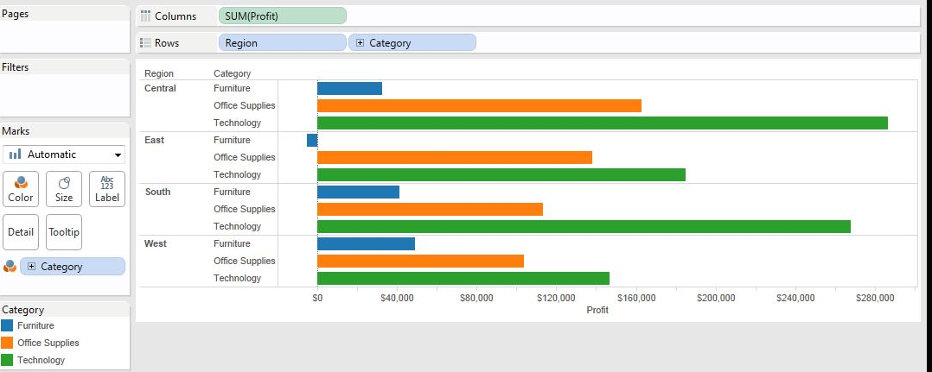
Bar Graph (1 measure by 2 dimensions) using tableau
This was actually more complex than Power View. In Power View, all we have to do is drag Category to the Legend Shelf. In Tableau, we have to drag it to both the Rows Shelf and the Colors Shelf. To our knowledge, Tableau is incapable of making clustered bar graphs. This is probably our biggest frustration with Tableau.
Winner: Power View.

Slide 12
Summary - Tableau vs Power pivot
Tableau destroyed Power Pivot with its ability to easily connect to different data sources.
However, Power Pivot edged out Tableau in its ability to get quick answers from clean data and typecast fields.
Now that we've gone through a few different important chart types, it's become apparent that Tableau is the better choice for basic charting. We realize that Tableau is not easily capable of creating clustered bar charts, which we find extremely useful.
Tableau opens the dashboard quickly. Note that the dashboard consisted of four varying types of charts created to stretch the tools. Power Pivot: 9 seconds Tableau: 3 seconds

Slide 13
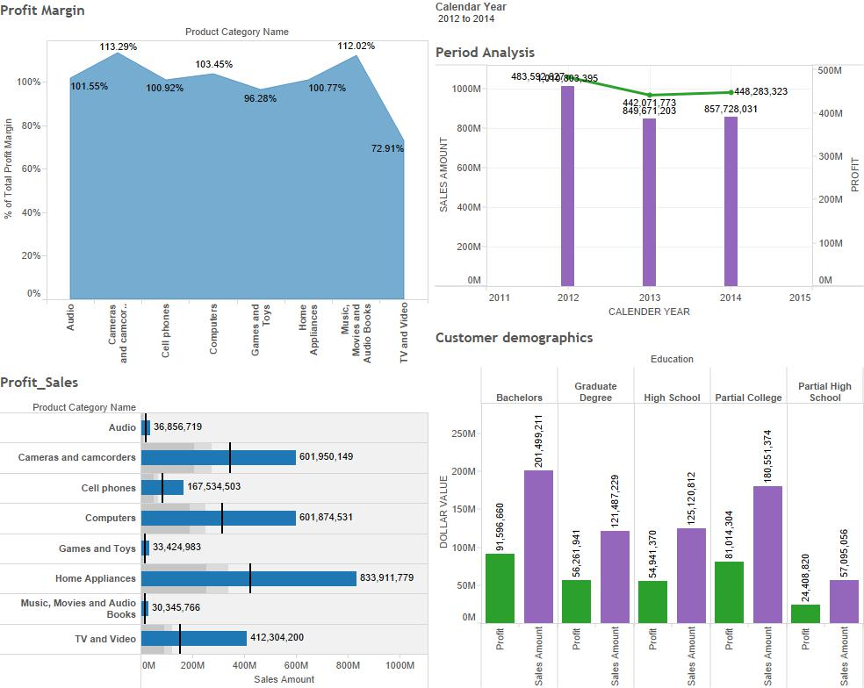

Slide 14
